Slide 1
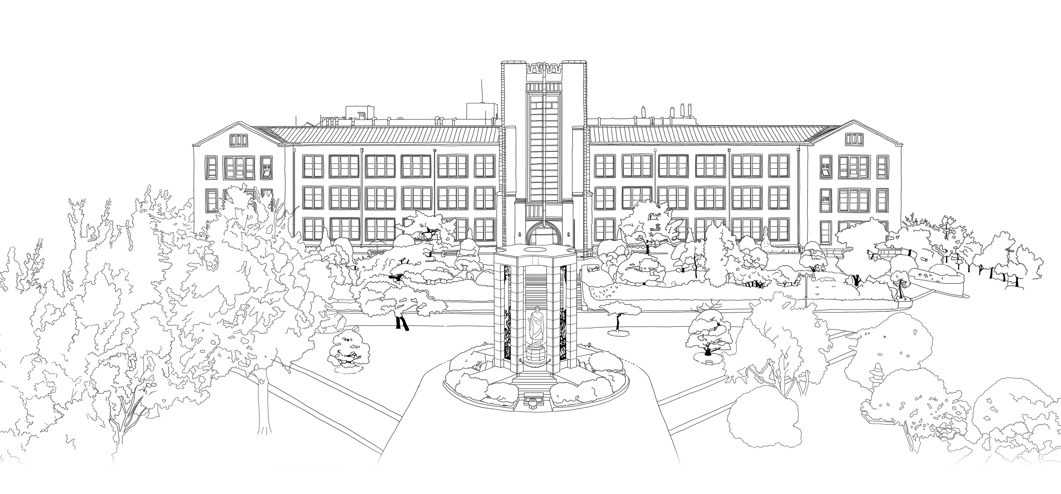
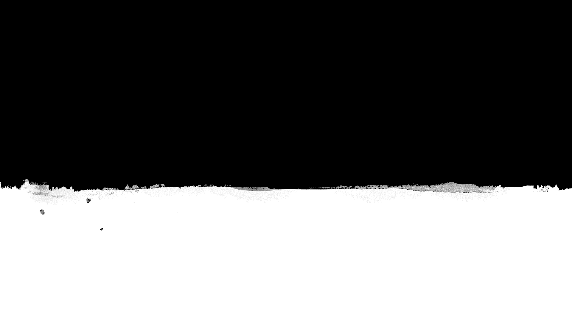

Introduction to Algorithms
DongYeon Kim
Department of Multimedia Engineering
Dongguk University

Slide 2
Contents
Chapter.1 Foundations
‘
;
0
Divide-and-Conquer
The maximum-subarray problem
Strassen’s algorithm for matrix multiplication
The substitution method for solving recurrences
The recursion-tree method for solving recurrences
Proof of the master theorem
Probabilistic Analysis and Randomized Algorithms
The hiring problem
Indicator random variables
Randomized algorithms
Probabilistic analysis and further uses of indicator random variables
The Role of Algorithms in Computing
Algorithms
Algorithms as a technology
Getting Started
Insertion sort
Analyzing algorithms
Designing algorithms
Growth of Functions
Asymptotic notation
Standard notations and common functions
Notes:
모든 Feature마다 이상치를 제거하게 되면 너무 많은 데이터 손실이 발생

Slide 3
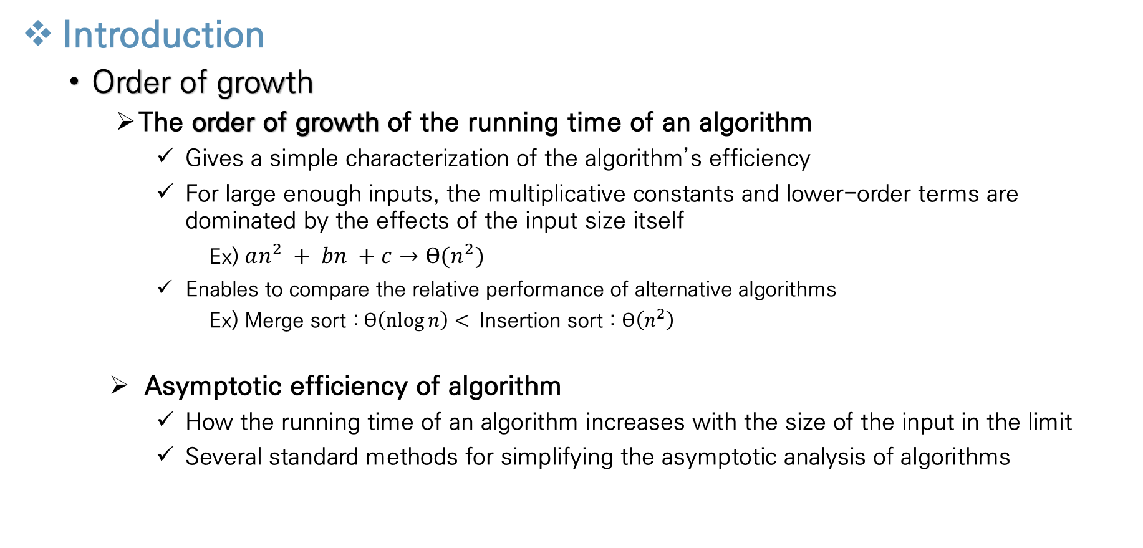
Growth of Functions
Introduction
Order of growth
The order of growth of the running time of an algorithm
Gives a simple characterization of the algorithm’s efficiency
For large enough inputs, the multiplicative constants and lower-order terms are dominated by the effects of the input size itself
Ex) $an^{2} + bn +c$ $→ϴ(n^{2})$
Enables to compare the relative performance of alternative algorithms
Ex) Merge sort :$ϴ\left(\operatorname{nlog}{n}\right)<$Insertion sort : $ϴ\left(n^{2}\right)$
Asymptotic efficiency of algorithm
How the running time of an algorithm increases with the size of the input in the limit
Several standard methods for simplifying the asymptotic analysis of algorithms
Notes:
모든 Feature마다 이상치를 제거하게 되면 너무 많은 데이터 손실이 발생

Slide 4
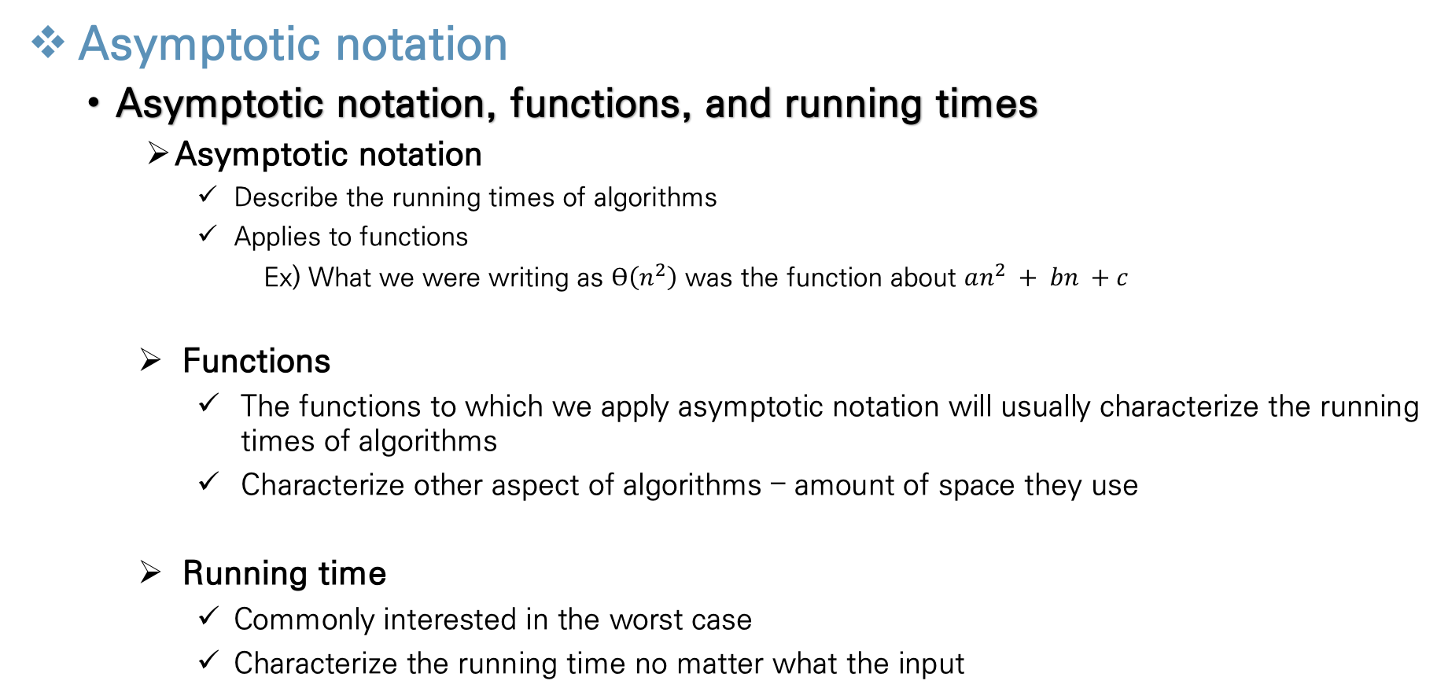
Growth of Functions
Asymptotic notation
Asymptotic notation, functions, and running times
Asymptotic notation
Describe the running times of algorithms
Applies to functions
Ex) What we were writing as $ϴ\left(n^{2}\right)$ was the function about $an^{2} + bn +c$
Functions
The functions to which we apply asymptotic notation will usually characterize the running times of algorithms
Characterize other aspect of algorithms – amount of space they use
Running time
Commonly interested in the worst case
Characterize the running time no matter what the input
Notes:
모든 Feature마다 이상치를 제거하게 되면 너무 많은 데이터 손실이 발생

Slide 5
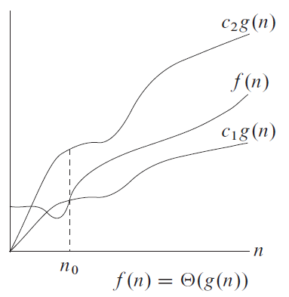
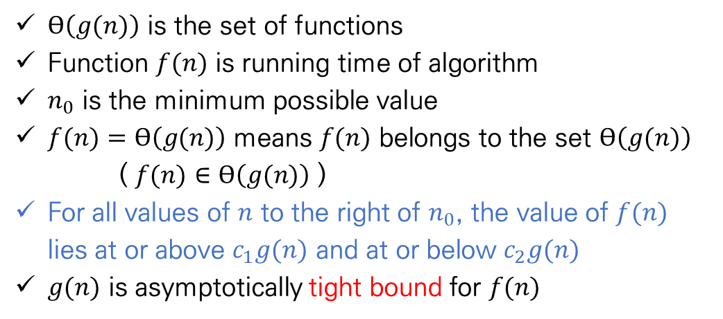
Growth of Functions
Asymptotic notation
𝚯 notation (Big- 𝚯 notation)
Definition
$ϴ\left(g(n)\right)$ is the set of functions
Function $f(n)$ is running time of algorithm
$n_{0}$ is the minimum possible value
$f(n)$ $=ϴ\left(g(n)\right)$ means $f(n)$ belongs to the set $ϴ\left(g(n)\right)$
( $f(n)$ $∈ϴ\left(g(n)\right)$ )
For all values of $n$ to the right of $n_{0}$, the value of $f(n)$ lies at or above $c_{1}g(n)$ and at or below $c_{2}g(n)$
$g(n)$ is asymptotically tight bound for $f(n)$
Notes:
모든 Feature마다 이상치를 제거하게 되면 너무 많은 데이터 손실이 발생

Slide 6
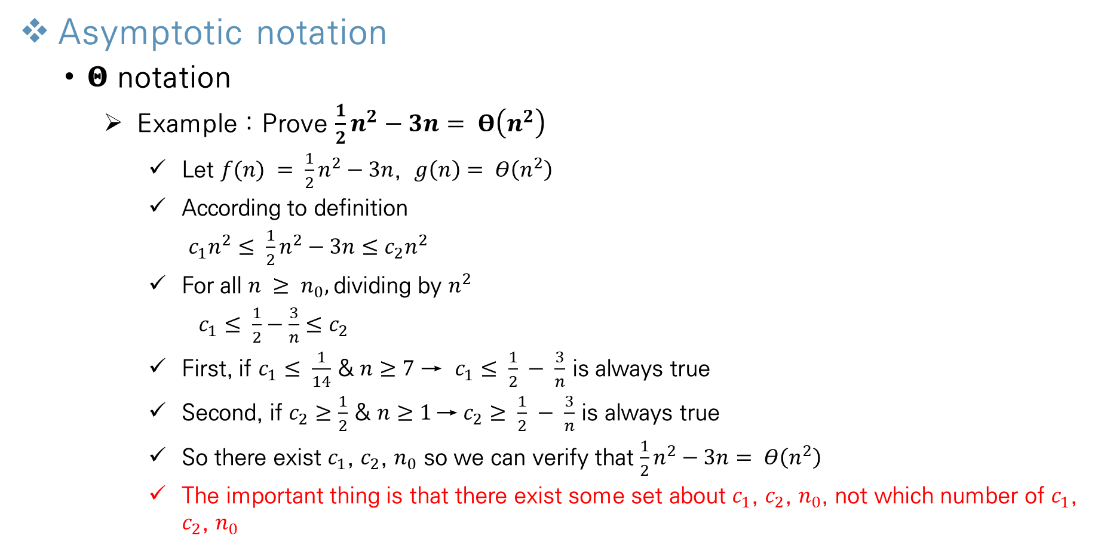
Growth of Functions
Asymptotic notation
𝚯 notation
Example : Prove $\frac{1}{2}n^{2}−3n= Θ\left(n^{2}\right)$
Let $f(n) = \frac{1}{2}n^{2}−3n$, $g\left(n\right)= Θ\left(n^{2}\right)$
According to definition
$c_{1}n^{2}≤ \frac{1}{2}n^{2}−3n≤c_{2}n^{2}$
For all $n ≥ n_{0},$dividing by $n^{2}$
$c_{1}≤ \frac{1}{2}−\frac{3}{n}≤c_{2}$
First, if $c_{1}≤ \frac{1}{14}$ & $n≥7$ → $c_{1}≤ \frac{1}{2} − \frac{3}{n}$ is always true
Second, if $c_{2}≥\frac{1}{2}$ & $n≥1$→ $c_{2}≥ \frac{1}{2} − \frac{3}{n}$ is always true
So there exist $c_{1}$, $c_{2}$, $n_{0}$ so we can verify that $\frac{1}{2}n^{2}−3n= Θ\left(n^{2}\right)$
The important thing is that there exist some set about $c_{1}$, $c_{2}$, $n_{0}$, not which number of $c_{1}$, $c_{2}$, $n_{0}$
Notes:
모든 Feature마다 이상치를 제거하게 되면 너무 많은 데이터 손실이 발생

Slide 7
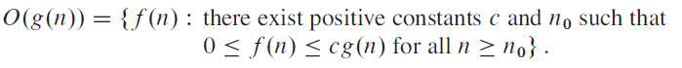
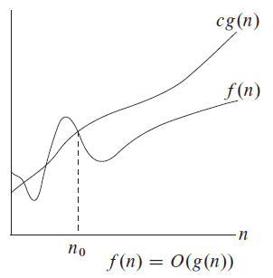
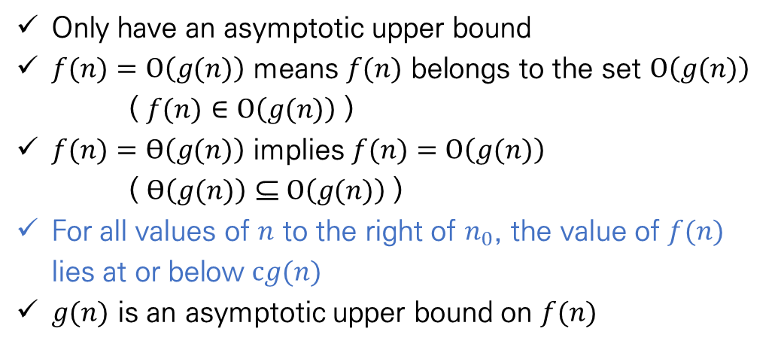
Growth of Functions
Asymptotic notation
O notation (Big-O notation)
Definition
Only have an asymptotic upper bound
$f(n)$ $=O\left(g(n)\right)$ means $f(n)$ belongs to the set $O\left(g(n)\right)$
( $f(n)$ $∈O\left(g(n)\right)$ )
$f(n)$ $=ϴ\left(g(n)\right)$ implies $f(n)$ $=O\left(g(n)\right)$
( $ϴ\left(g(n)\right) \text{⊆} O\left(g(n)\right)$ )
For all values of $n$ to the right of $n_{0}$, the value of $f(n)$ lies at or below $cg(n)$
$g(n)$ is an asymptotic upper bound on $f(n)$
Notes:
Big o of g of n

Slide 8
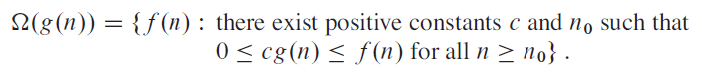
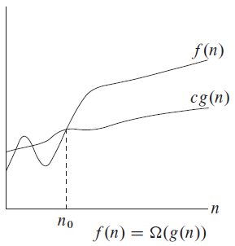
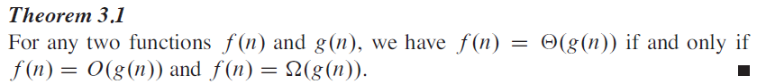
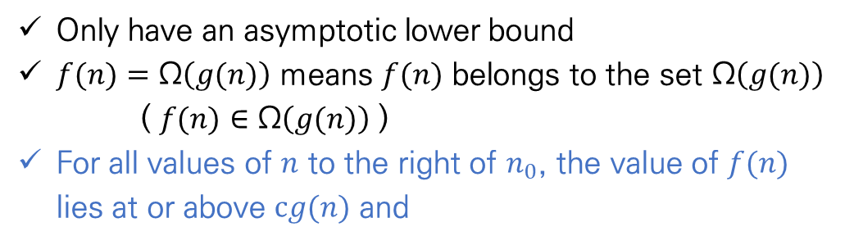
Growth of Functions
Asymptotic notation
Ω notation (Big- Ω notation)
Definition
Only have an asymptotic lower bound
$f(n)$ $=\text{Ω}\left(g(n)\right)$ means $f(n)$ belongs to the set Ω$\left(g(n)\right)$
( $f(n)$ $∈\text{Ω}\left(g(n)\right)$ )
For all values of $n$ to the right of $n_{0}$, the value of $f(n)$ lies at or above $cg(n)$ and
Notes:
모든 Feature마다 이상치를 제거하게 되면 너무 많은 데이터 손실이 발생

Slide 9
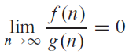
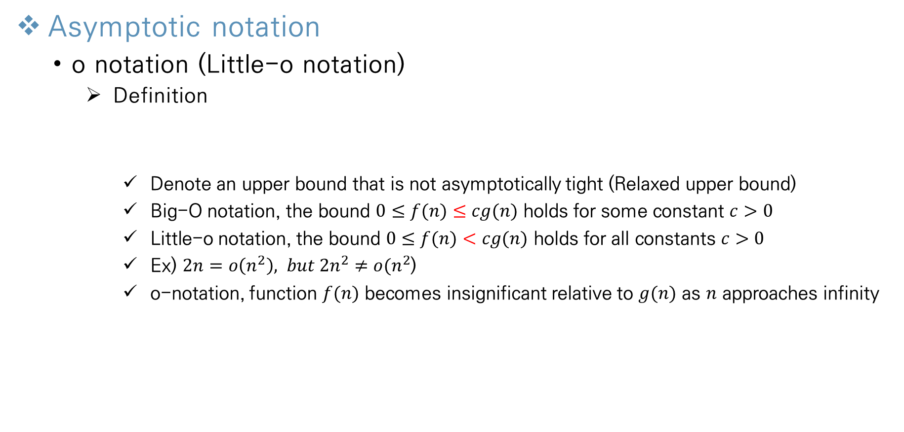
Growth of Functions
Asymptotic notation
o notation (Little-o notation)
Definition
Denote an upper bound that is not asymptotically tight (Relaxed upper bound)
Big-O notation, the bound $0≤f(n)≤cg(n)$ holds for some constant $c>0$
Little-o notation, the bound $0≤f(n)<cg(n)$ holds for all constants $c>0$
Ex) $2n=o\left(n^{2}\right), but 2n^{2}≠o(n^{2}$)
o-notation, function $f(n)$ becomes insignificant relative to $g(n)$ as $n$ approaches infinity
Notes:
모든 Feature마다 이상치를 제거하게 되면 너무 많은 데이터 손실이 발생

Slide 10

Growth of Functions
Asymptotic notation
$ω$ notation (Little-$ω$ notation)
Definition
Denote a lower bound that is not asymptotically tight (Relaxed lower bound)
Big-Ω notation, the bound $0≤cg(n)≤f(n)$ holds for some constant $c>0$
Little-$ω$ notation, the bound $0≤cg(n)<f(n)$holds for all constants $c>0$
Ex) $\frac{n^{2}}{2}=ω\left(n\right), but \frac{n^{2}}{2}≠ω(n^{2}$)
o-notation, function $f(n)$ becomes insignificant relative to $g(n)$ as $n$ approaches infinity
Notes:
모든 Feature마다 이상치를 제거하게 되면 너무 많은 데이터 손실이 발생

Slide 11
Divide and Conquer
Introduction
Divide and Conquer
Solve a problem recursively, applying three steps
Divide the problem into some subproblems that are smaller instances of the same problem
Conquer the subproblems by solving them recursively.
If the subproblem sizes are small enough, just solve the subproblems in a straightforward manner
Recursive case: subproblems are large enough to solve recursively
Base case: subproblems become small enough that no longer recurse
Combine the solutions to the subproblems into the original problem
Sometimes, we solve subproblems that are not the same as the original problem
consider solving such subproblems that are not quite the same as the original problem
We will solve two Divide and Conquer problem
maximum-subarray problem
Multiplying N x N matrices
Notes:
모든 Feature마다 이상치를 제거하게 되면 너무 많은 데이터 손실이 발생

Slide 12
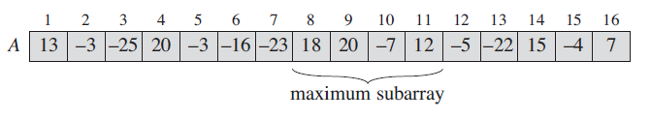
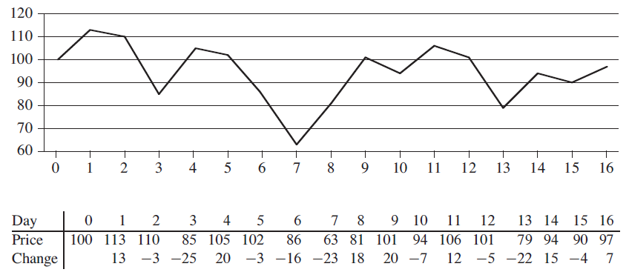
Divide and Conquer
The maximum subarray problem
Definition
Task to find the series of continuous elements with the maximum sum in any given array
It is trivial if all elements in the array are non-negative
Price of stock problem
X axis: date Y axis: stock price
The bottom row of the table gives the change in price from the previous day
Have to find maximum profit → find maximum subarray in bottom row of the table
Notes:
모든 Feature마다 이상치를 제거하게 되면 너무 많은 데이터 손실이 발생

Slide 13
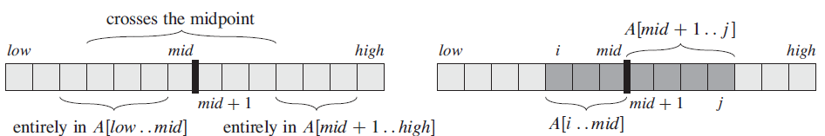
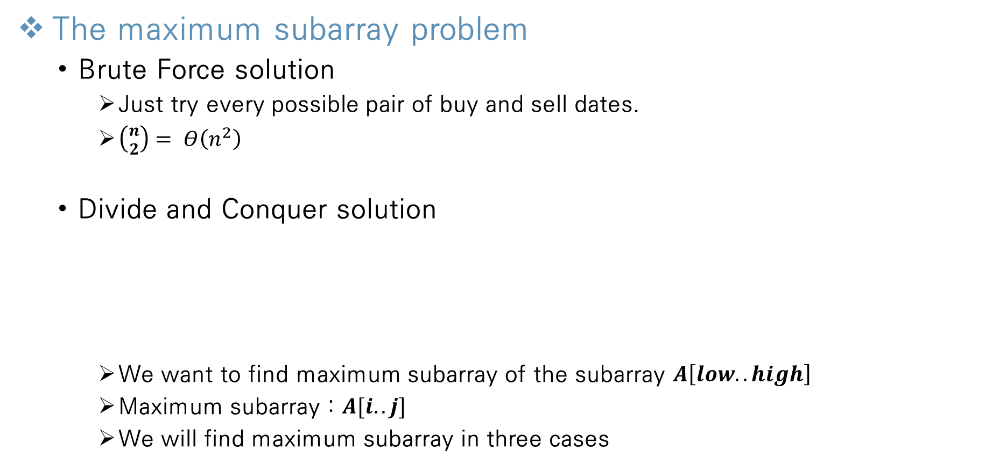
Divide and Conquer
The maximum subarray problem
Brute Force solution
Just try every possible pair of buy and sell dates.
$\left({n \atop 2}\right)= Θ\left(n^{2}\right)$
Divide and Conquer solution
We want to find maximum subarray of the subarray $A\left[low..high\right]$
Maximum subarray : $A[i..j]$
We will find maximum subarray in three cases
Notes:
N squared
N cubed
N to the forth

Slide 14
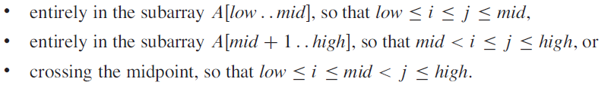
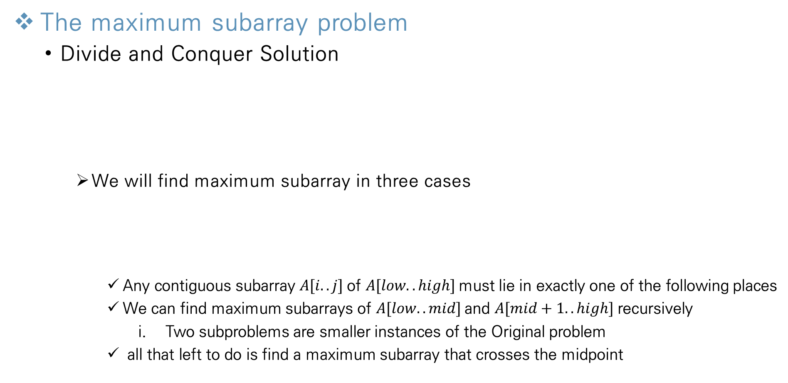
Divide and Conquer
The maximum subarray problem
Divide and Conquer Solution
We will find maximum subarray in three cases
Any contiguous subarray $A[i..j]$of $A[low..high]$must lie in exactly one of the following places
We can find maximum subarrays of $A[low..mid]$and $A[mid+1..high]$recursively
Two subproblems are smaller instances of the Original problem
all that left to do is find a maximum subarray that crosses the midpoint
Notes:
모든 Feature마다 이상치를 제거하게 되면 너무 많은 데이터 손실이 발생

Slide 15
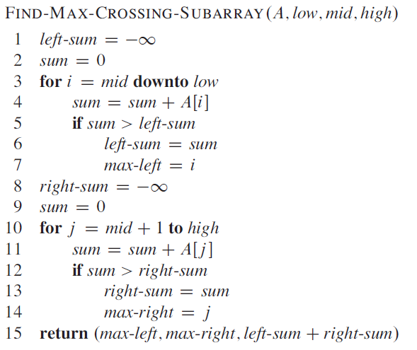
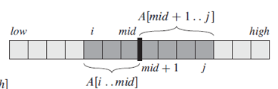
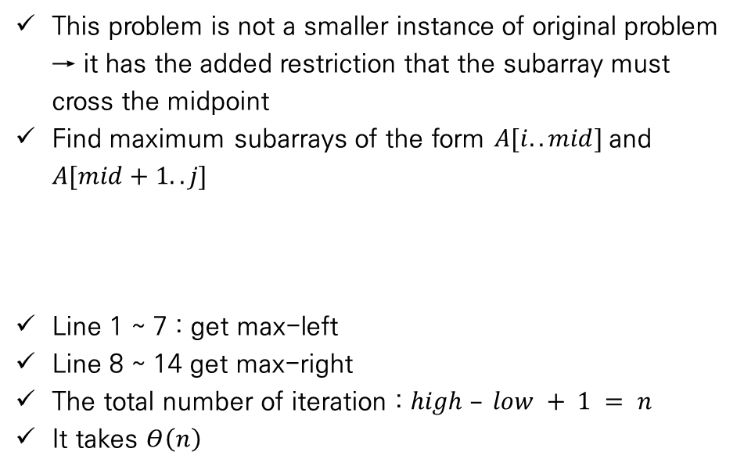
Divide and Conquer
The maximum subarray problem
Divide and Conquer Solution
Find a maximum subarray that crosses the midpoint
This problem is not a smaller instance of original problem → it has the added restriction that the subarray must cross the midpoint
Find maximum subarrays of the form $A[i..mid]$and $A[mid+1..j]$
Line 1 ~ 7 : get max-left
Line 8 ~ 14 get max-right
The total number of iteration : $high – low + 1 = n$
It takes $Θ\left(n\right)$
Notes:
모든 Feature마다 이상치를 제거하게 되면 너무 많은 데이터 손실이 발생

Slide 16
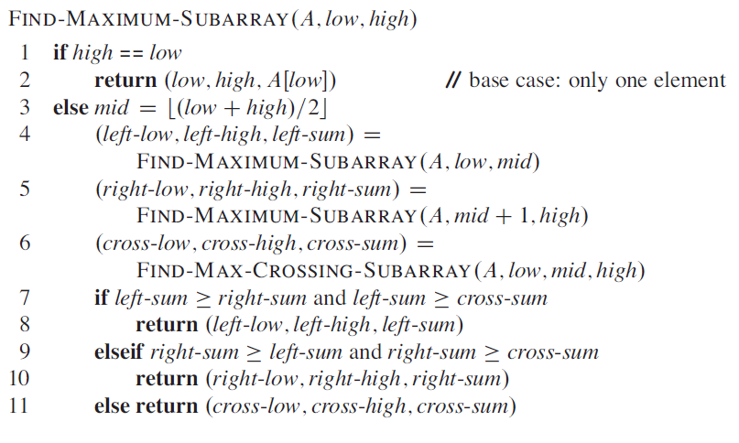
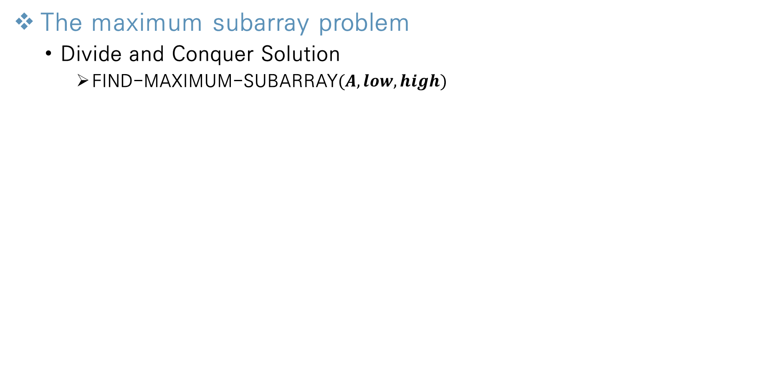
Divide and Conquer
The maximum subarray problem
Divide and Conquer Solution
FIND-MAXIMUM-SUBARRAY$(A,low,high)$
Line 4~5: recursively solve the problem (left & right)
Line 6: find max crossing subarray
Line 7~11: fine maximum subarray out of the three cases
Notes:
모든 Feature마다 이상치를 제거하게 되면 너무 많은 데이터 손실이 발생

Slide 17
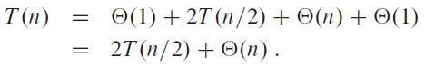
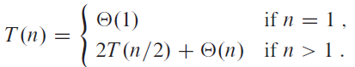
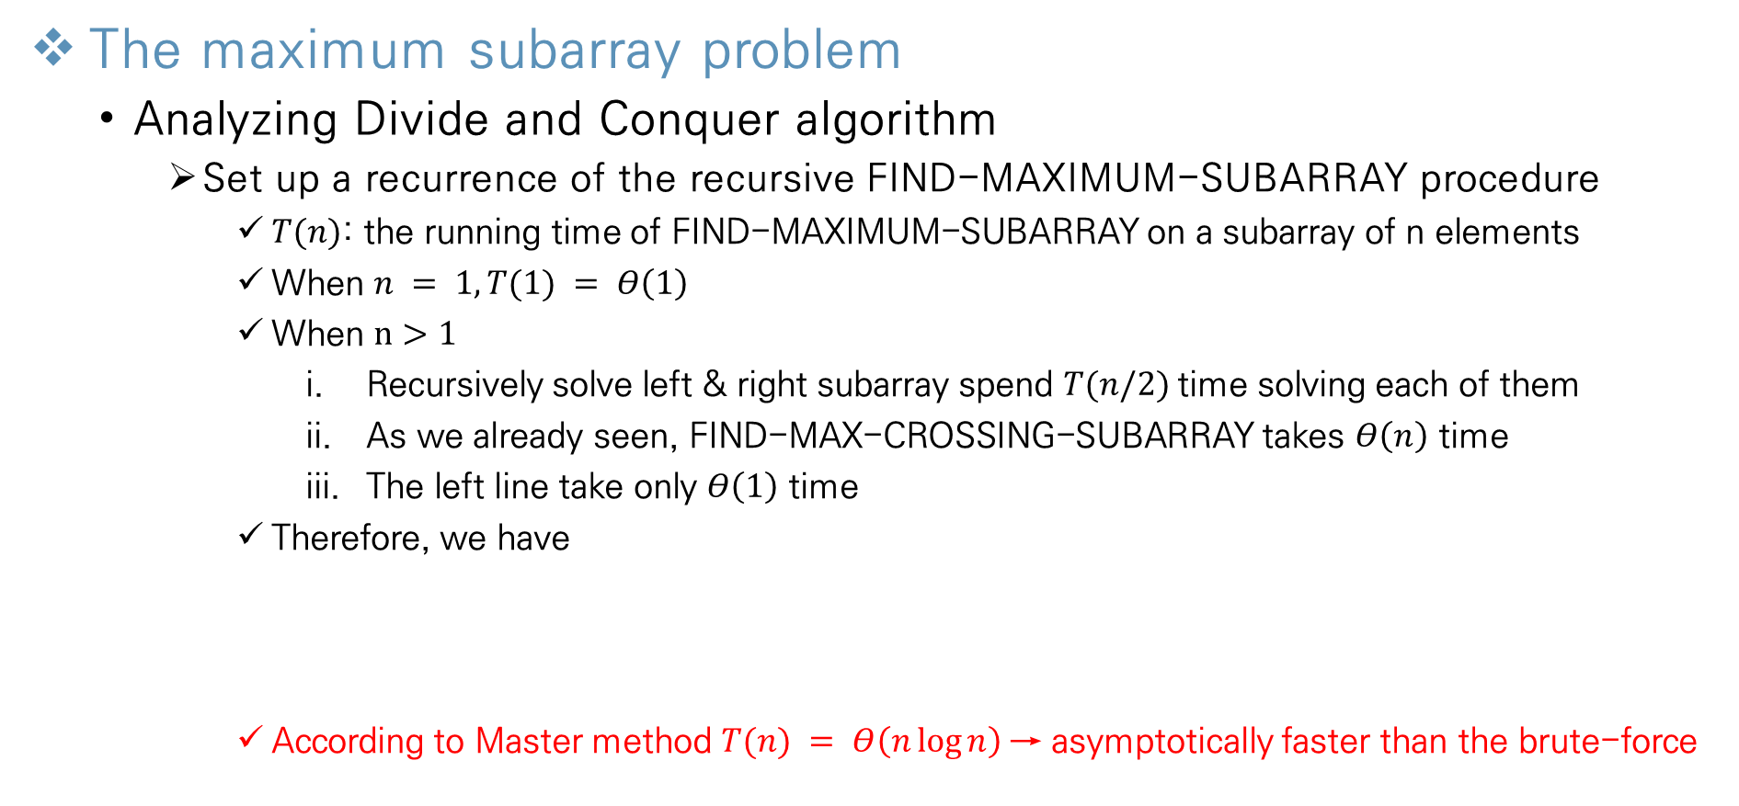
Divide and Conquer
The maximum subarray problem
Analyzing Divide and Conquer algorithm
Set up a recurrence of the recursive FIND-MAXIMUM-SUBARRAY procedure
$T(n)$: the running time of FIND-MAXIMUM-SUBARRAY on a subarray of n elements
When $n = 1, T(1) = Θ\left(1\right)$
When $n>1$
Recursively solve left & right subarray spend $T(n/2)$time solving each of them
As we already seen, FIND-MAX-CROSSING-SUBARRAY takes $Θ\left(n\right)$ time
The left line take only $Θ\left(1\right)$ time
Therefore, we have
According to Master method $T(n) = Θ\left(n\log{n}\right)$→ asymptotically faster than the brute-force
Notes:
모든 Feature마다 이상치를 제거하게 되면 너무 많은 데이터 손실이 발생

Slide 18
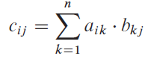
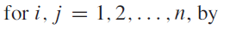
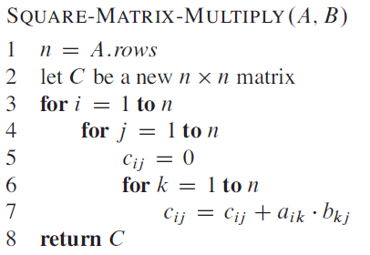
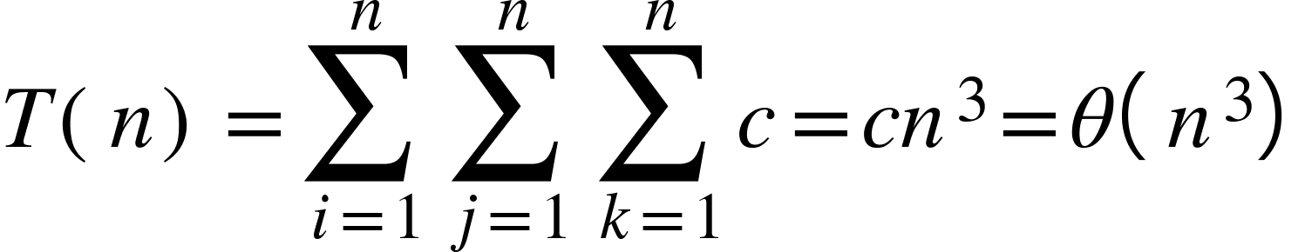
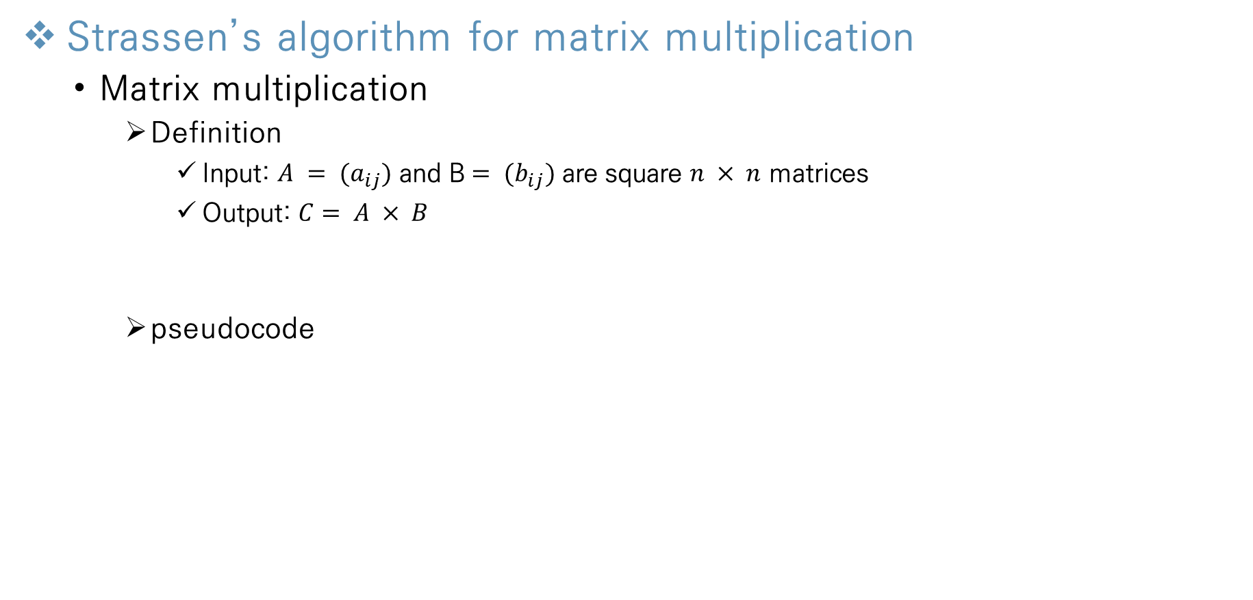
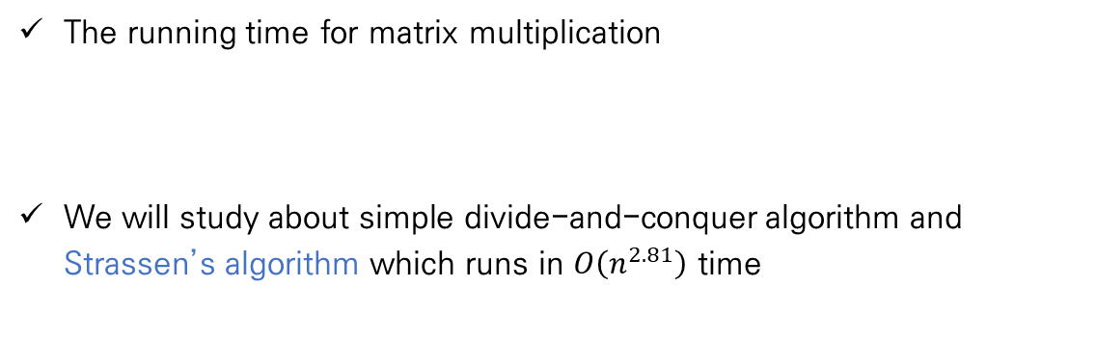
Divide and Conquer
Strassen’s algorithm for matrix multiplication
Matrix multiplication
Definition
Input: $A = {(a}_{ij})$ and B$= {(b}_{ij})$ are square $n × n$ matrices
Output: $C= A × B$
pseudocode
The running time for matrix multiplication
We will study about simple divide-and-conquer algorithm and Strassen’s algorithm which runs in $O\left(n^{2.81}\right)$ time
Notes:
모든 Feature마다 이상치를 제거하게 되면 너무 많은 데이터 손실이 발생

Slide 19
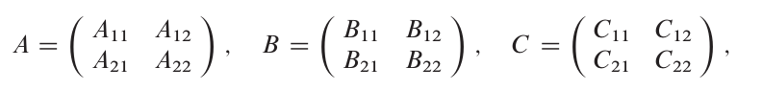
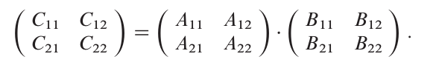
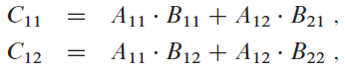
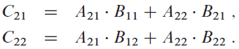
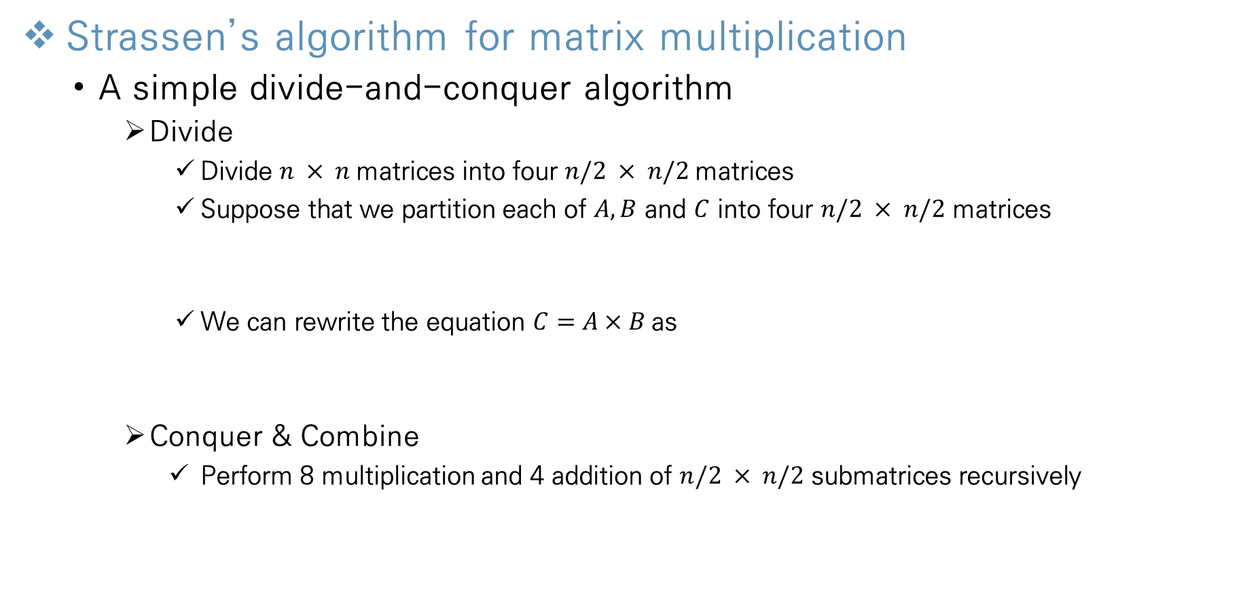
Divide and Conquer
Strassen’s algorithm for matrix multiplication
A simple divide-and-conquer algorithm
Divide
Divide $n × n$matrices into four $n/2 × n/2$matrices
Suppose that we partition each of $A,B$ and $C$ into four $n/2 × n/2$ matrices
We can rewrite the equation $C=A×B$as
Conquer & Combine
Perform 8 multiplication and 4 addition of $n/2 × n/2$ submatrices recursively
Notes:
모든 Feature마다 이상치를 제거하게 되면 너무 많은 데이터 손실이 발생

Slide 20
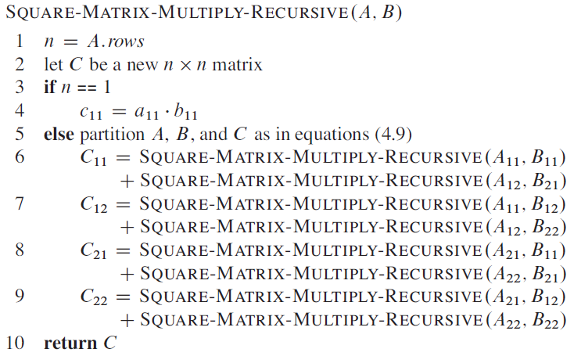
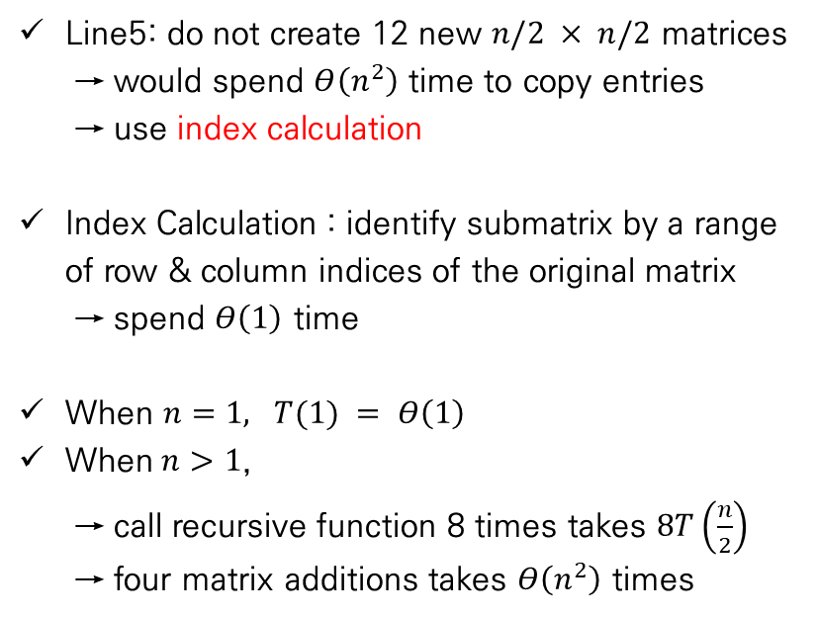
Divide and Conquer
Strassen’s algorithm for matrix multiplication
A simple divide-and-conquer algorithm
Pseudocode & analyzing
Line5: do not create 12 new $n/2 × n/2$ matrices
→ would spend $Θ\left(n^{2}\right)$ time to copy entries
→ use index calculation
Index Calculation : identify submatrix by a range of row & column indices of the original matrix
→ spend $Θ\left(1\right)$ time
When $n=1, T(1) = Θ\left(1\right)$
When$n>1$,
→ call recursive function 8 times takes $8T\left(\frac{n}{2}\right)$
→ four matrix additions takes $Θ\left(n^{2}\right)$ times
Notes:
모든 Feature마다 이상치를 제거하게 되면 너무 많은 데이터 손실이 발생

Slide 21
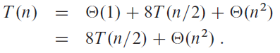
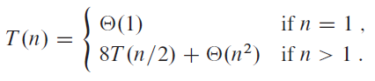
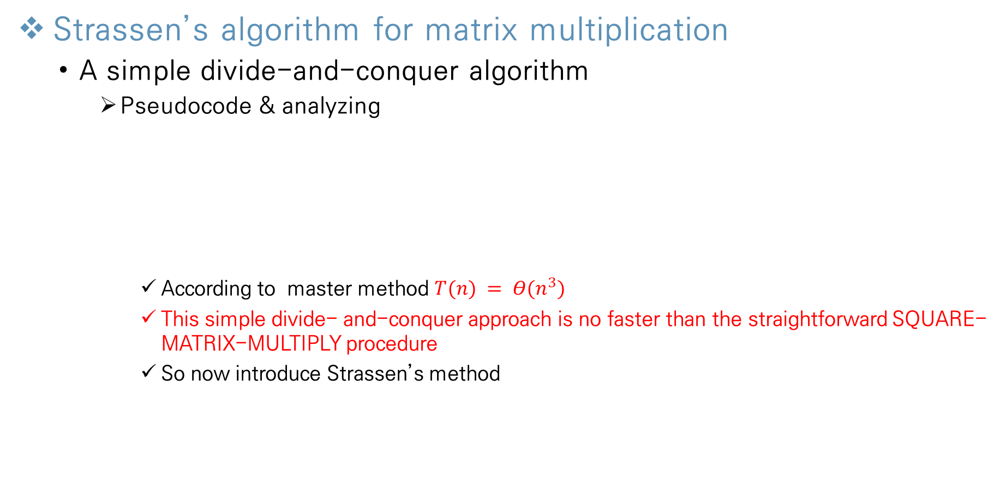
Divide and Conquer
Strassen’s algorithm for matrix multiplication
A simple divide-and-conquer algorithm
Pseudocode & analyzing
According to master method $T(n) = Θ(n^{3})$
This simple divide- and-conquer approach is no faster than the straightforward SQUARE-MATRIX-MULTIPLY procedure
So now introduce Strassen’s method
Index Calculation
8 Multiplications
4 Additions
Notes:
모든 Feature마다 이상치를 제거하게 되면 너무 많은 데이터 손실이 발생

Slide 22
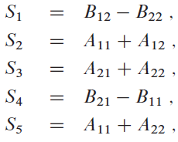
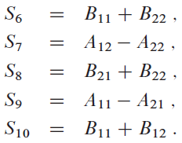
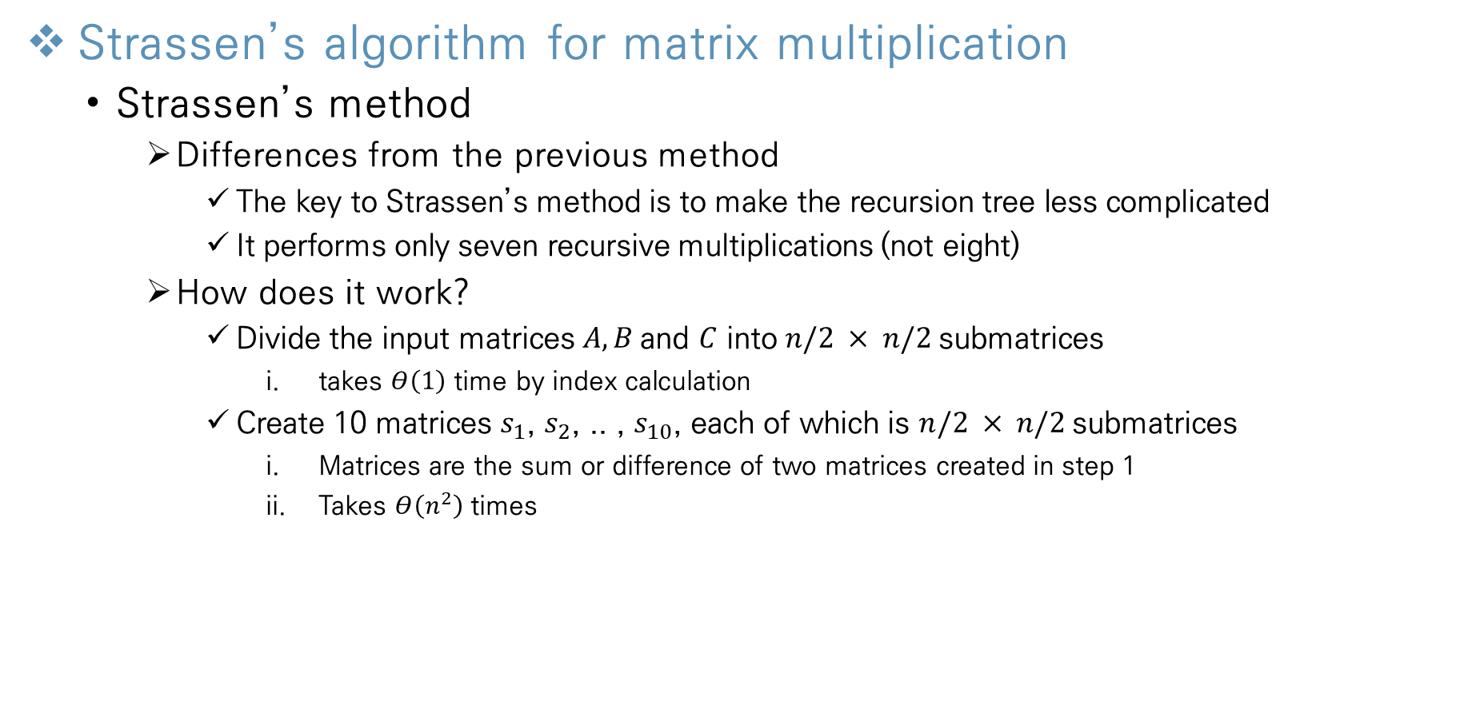
Divide and Conquer
Strassen’s algorithm for matrix multiplication
Strassen’s method
Differences from the previous method
The key to Strassen’s method is to make the recursion tree less complicated
It performs only seven recursive multiplications (not eight)
How does it work?
Divide the input matrices $A, B$and $C$ into $n/2 × n/2$submatrices
takes $Θ\left(1\right)$ time by index calculation
Create 10 matrices $s_{1}$, $s_{2}$, .. , $s_{10}$, each of which is $n/2 × n/2$submatrices
Matrices are the sum or difference of two matrices created in step 1
Takes $Θ\left(n^{2}\right)$ times
Notes:
모든 Feature마다 이상치를 제거하게 되면 너무 많은 데이터 손실이 발생

Slide 23
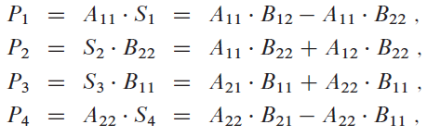



Divide and Conquer
Strassen’s algorithm for matrix multiplication
Strassen’s method
How does it work?
Using the submatrices created in step 1 and the 10 matrices created in step 2, recursively compute seven matrix products $P_{1}$, $P_{2}$, .. , $P_{7}$ which are $n/2 × n/2$submatrices
Require us to perform seven multiplications of $n/2 × n/2$ matrices
Takes $7T(n/2)$ times
Compute the desired submatrices $C_{11},C_{12}$, $C_{21}$, $C_{22}$ of the result matrix C by adding and subtracting carious combinations of the $P_{i}$ matrices.
i. Takes $Θ\left(n^{2}\right)$ times
Notes:
모든 Feature마다 이상치를 제거하게 되면 너무 많은 데이터 손실이 발생

Slide 24





Divide and Conquer
Strassen’s algorithm for matrix multiplication
Strassen’s method
Analyzing algorithm
T(n) = $Θ\left(1\right)+Θ\left(n^{2}\right)+7T\left(\frac{n}{2}\right)+Θ\left(n^{2}\right)$
= $7T\left(\frac{n}{2}\right)+Θ\left(n^{2}\right)$
According to master method $T\left(n\right)= Θ\left(n^{\log{7}}\right)= Θ\left(n^{2.8}\right)$
Strassen’s algorithm, comparing with previous methods, is asymptotically faster!!
Index Calculation
Create 10 $s_{i}$
Calculate 7 $P_{i}$
Compute $c_{i}$
Notes:
모든 Feature마다 이상치를 제거하게 되면 너무 많은 데이터 손실이 발생

Slide 25
Thank You!

